Slide 1
TRAVEL MANAGEMENT SYSTEM
ECS200
SOFTWARE ENGINEERING & PROJECT
SRI LANKA TECHNOLOGICAL CAMPUS

Slide 2

TEAM MEMBERS – GROUP E
AA1401- H.M.V.M.N.Herath
AA1471- K.K.Dhananjanee
AA1512- N.P.P.M.D.M.G.T.Panditharathna
AA2077- W.M.G.K.G.K.T.B.Weerakoon
AA1347- K.K.H.P.Siriwardhana
AA1349- D.K.G.C.Wijayawardhana
AA1404- H.P.V.P.Pathirana
AA1384- W.A.T.M.Wirasagoda
AA1381- D.M.K.Methsara Dissanayaka
AA1450- J.M.Raveesha Thathsarani

Slide 3

TABLE OF CONTENTS
01. INTRODUCTION & BACKGROUND
02. ARCHITECTURE & SOLUTION
03. DEMONSTRATION
04. QUESTIONS & ANSWERS

Slide 4

01. INTRODUCTION & BACKGROUND
This software is mainly focused on travelers. The main purpose of making this software is to manage travelers by helping them to identify the most suitable places according to their preferences, giving the information about facilities like hotels and restaurants, easy routes for their visiting places, providing details about vehicles for their journeys according to their budget and etc..
According to the old method, these all features can’t be found in one place. But our target is to make a software which will provide all this information in one place. Normally people use to find websites and travel magazines and etc. to prepare for their journeys. But through this software, we try to help travelers to get all the necessities for their journeys easily in one place.

Slide 5
02. ARCHITECTURE & SOLUTION
Functionalities of the components in the system are determined by a good systems design. The selection of a better modelling technique is important at this stage.
Basically in a Travel management system, traveler or the user plays a major role.
The user of this software can do the following functions;
Finding the preferred destination
Finding the preferred accommodation
Finding the status of the global pandemic

Slide 6
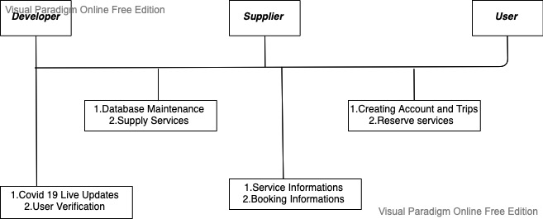

Slide 7
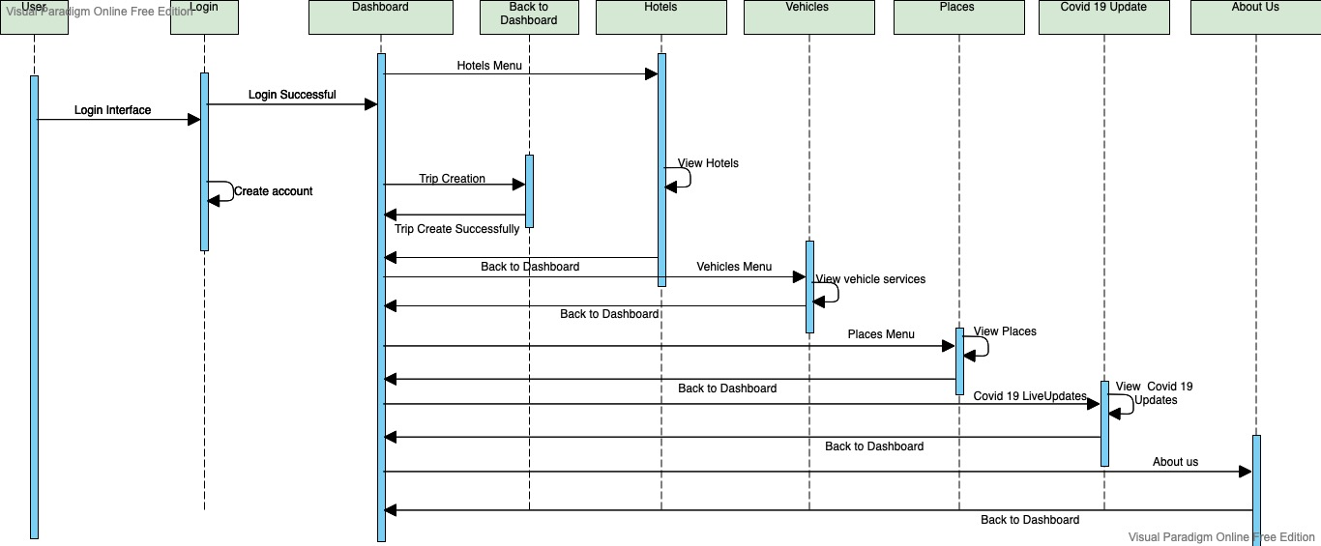
Sequence Diagram – Operations Of Travel Management System.

Slide 8

DIFFICULTIES ARISEN
Lack of understanding about how to design software. It also includes a lack of programming skills and an understanding of software development concepts.
Many communications issues raised within the team members as a result of the epidemic.
Creating the system in accordance with the necessary coding standards.
Using software to automate the entire procedure.
Completing the task within the time span allocated.

Slide 9
FUTURE IMPROVEMENTS AND DEVELOPMENTS
Further developing of “My Account” interface in order to display all the trips created by the users.
Further developing the hotel and vehicle bookings pages by linking the pages.
Filtering and displaying the hotels in between the starting and ending points of the journey.
Linking of social medias.

Slide 10
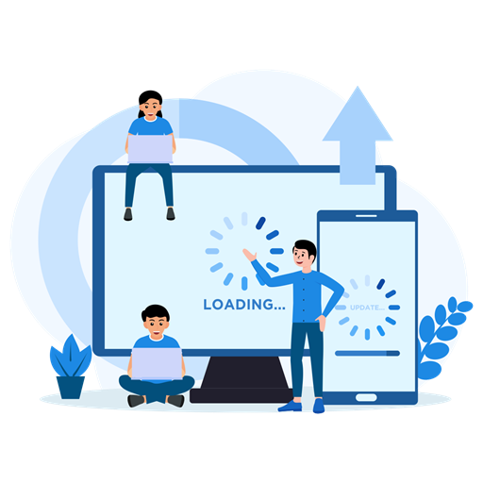
03. DEMONSTRATION

Slide 11

Thank You

